Slide 1

Auctioneer IIITDMJ
Prakhar Raghuvanshi – 20BCS160 Atul Raj – 20BCS046 Bussari Jashwanth Jee – 20BCS061
Submitted to-
Prof. Pritee Khanna

Slide 2
Introduction
The following project named Auctioneer IIITDMJ, is being made by the following members: 1. Prakhar Raghuvanshi – 20BCS160 2. Atul Raj – 20BCS046 3. Bussari Jashwanth Jee – 20BCS061
This project is being made under the guidance of Mr. Amit Bhati.

Slide 3
Purpose and Scope
Through this web application we would like to develop an interface for students of IIIT Jabalpur to buy and sell items within themselves.
This web application works on the principle where one can list their products for an auction, and finally that product will be sold to the highest bidder.
This application will enable final year students to easily list and sell their Cycles, Mattresses, Coolers, etc before leaving the campus. And will also get those essentials to the freshers at much lower price.

Slide 4
Users-
This web application will be used by our collage students so that they can buy and sell products using bidding system.
Under the project the following are the users
User Name | Password | Position
admin | admin123 | Administrator
prakhar | 123 | user
Atul | 123` | user
Jaswanth | 123 | user

Slide 5
Technology used
Basic Frontend 1. HTML 2. CSS
Framework
.Font-awesome | fonts and icon pack
.DataTables|Table plugin for jQuery
.Bootstrap | pop-up, Containers, etc
Backend 1. PHP 2. MySQL 3.Jquery
4.JavaScript

Slide 6
System Features
Buy-
Verified user (lets say Rahul) can bid on any available product, suppose his bid is the highest.
After the Due-date of the bid ends,the admin will get to know the highest bidder.
Admin will now send the information to the seller about the buyer and the transaction can be completed from other end.

Slide 7
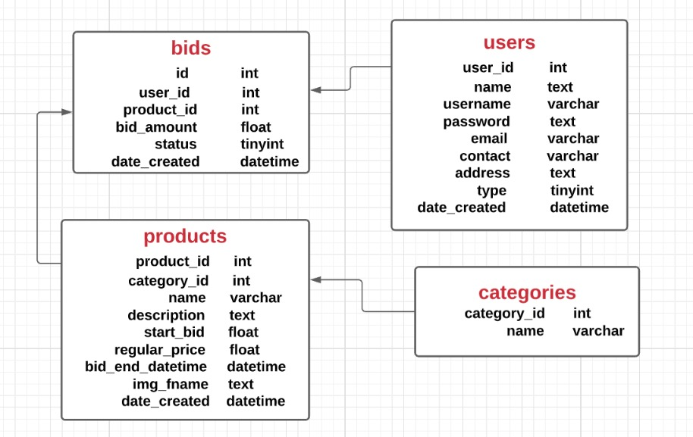
Database Schema

Slide 8
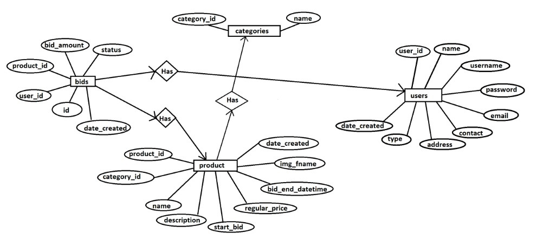
ER Diagram

Slide 9
System UI and ScreenShots

